Slide 1

PROJECT : Operating system lab(COM - 312)
presentation
Submitted by
AAKASH SUDAN (2021A1R159)
MANIK SHARMA(2021A1R161)
RAGHAV ANTHAL(2021A1R162)
NAVJYOT(2021A1R163)
Submitted To
Assistant Professor
Mr. Saurabh Sharma
DEPARTMENT OF COMPUTER SCIENCE AND ENGINEERING
MIET(Autonomous), JAMMU

Slide 2
Table of Contents:
Introduction
Key Terms
Scheduling algorithms
Code

Slide 3
INTRODUCTION
Scheduling of processes/work is done to finish the work on time.
CPU Scheduling allows one process to use the CPU while another process is delayed (in standby) due to unavailability of any resources such as I / O etc, thus making full use of the CPU.
The purpose of CPU Scheduling is to make the system more efficient, faster, and fairer.

Slide 4
Need for CPU scheduling algorithm?
In Multiprogramming, if the long-term scheduler selects multiple I / O binding processes then most of the time, the CPU remains an idle. The function of an effective program is to improve resource utilization.
If most operating systems change their status from performance to waiting then there may always be a chance of failure in the system. So in order to minimize this excess, the OS needs to schedule tasks in order to make full use of the CPU and avoid the possibility of deadlock.

Slide 5
KEY TERMS
Arrival Time: Time at which the process arrives in the ready queue.
Completion Time: Time at which process completes its execution.
Burst Time: Time required by a process for CPU execution.
Turn Around Time: Time Difference between completion time and arrival time.
Waiting Time(W.T): Time Difference between turn around time and burst time.

Slide 6
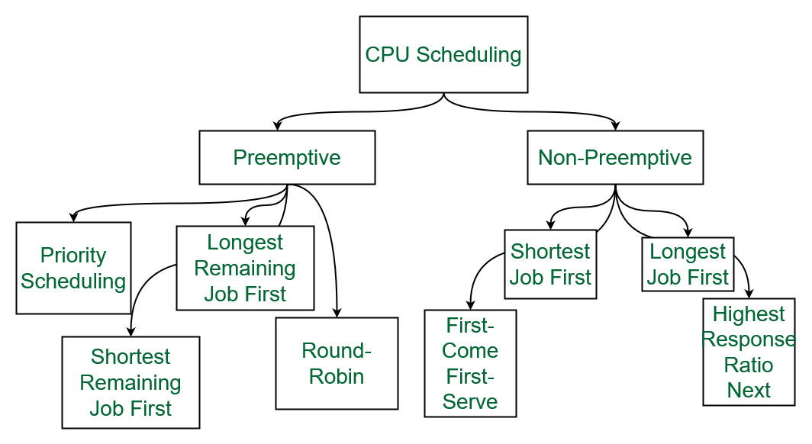
Different types of CPU Scheduling Algorithms?
source:geeksforgeeks.org

Slide 7
FCFS(First Come First Serve)
FCFS considered to be the simplest of all operating system scheduling algorithms. First come first serve scheduling algorithm states that the process that requests the CPU first is allocated the CPU first and is implemented by using FIFO queue.
Characteristics of FCFS:
FCFS supports non-preemptive and preemptive CPU scheduling algorithms.
Tasks are always executed on a First-come, First-serve concept.
FCFS is easy to implement and use.
This algorithm is not much efficient in performance, and the wait time is quite high.

Slide 8
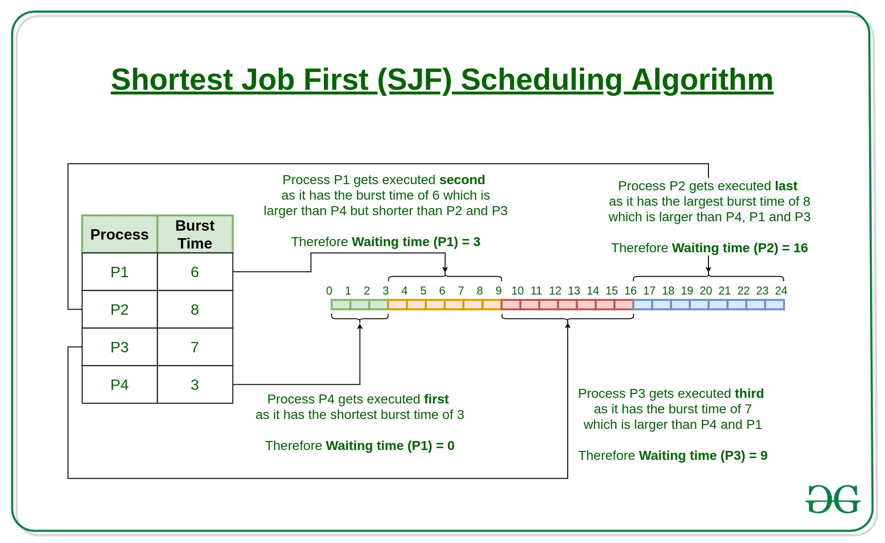
Shortest Job First(SJF)
Shortest job first (SJF) is a scheduling process that selects the waiting process with the smallest execution time to execute next. This scheduling method may or may not be preemptive. Significantly reduces the average waiting time for other processes waiting to be executed. The full form of SJF is Shortest Job First.
image source:geeksforgeeks.org

Slide 9
Shortest Remaining Time First
Shortest remaining time first is the preemptive version of the Shortest job first which we have discussed earlier where the processor is allocated to the job closest to completion. In SRTF the process with the smallest amount of time remaining until completion is selected to execute.
Characteristics of Shortest remaining time first:
SRTF algorithm makes the processing of the jobs faster than SJF algorithm, given it’s overhead charges are not counted.
The context switch is done a lot more times in SRTF than in SJF and consumes the CPU’s valuable time for processing. This adds up to its processing time and diminishes its advantage of fast processing.

Slide 10
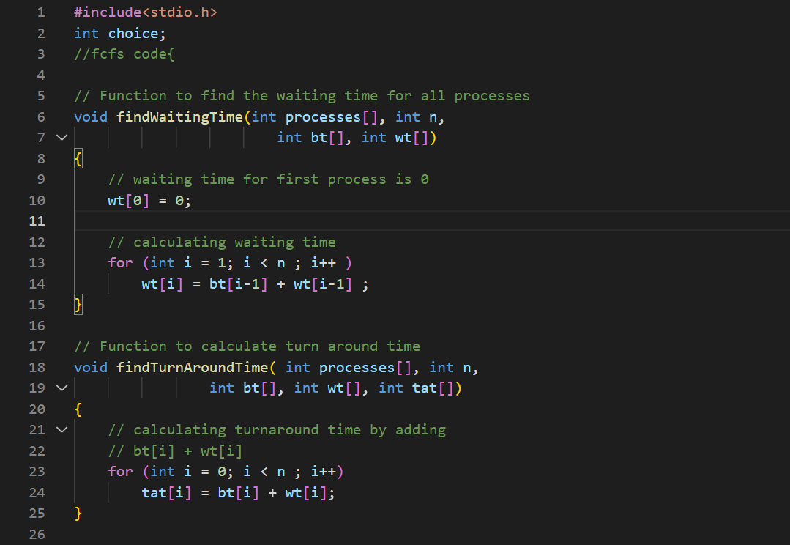
code

Slide 11
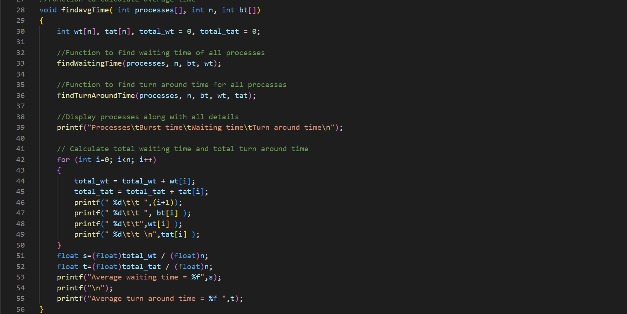

Slide 12
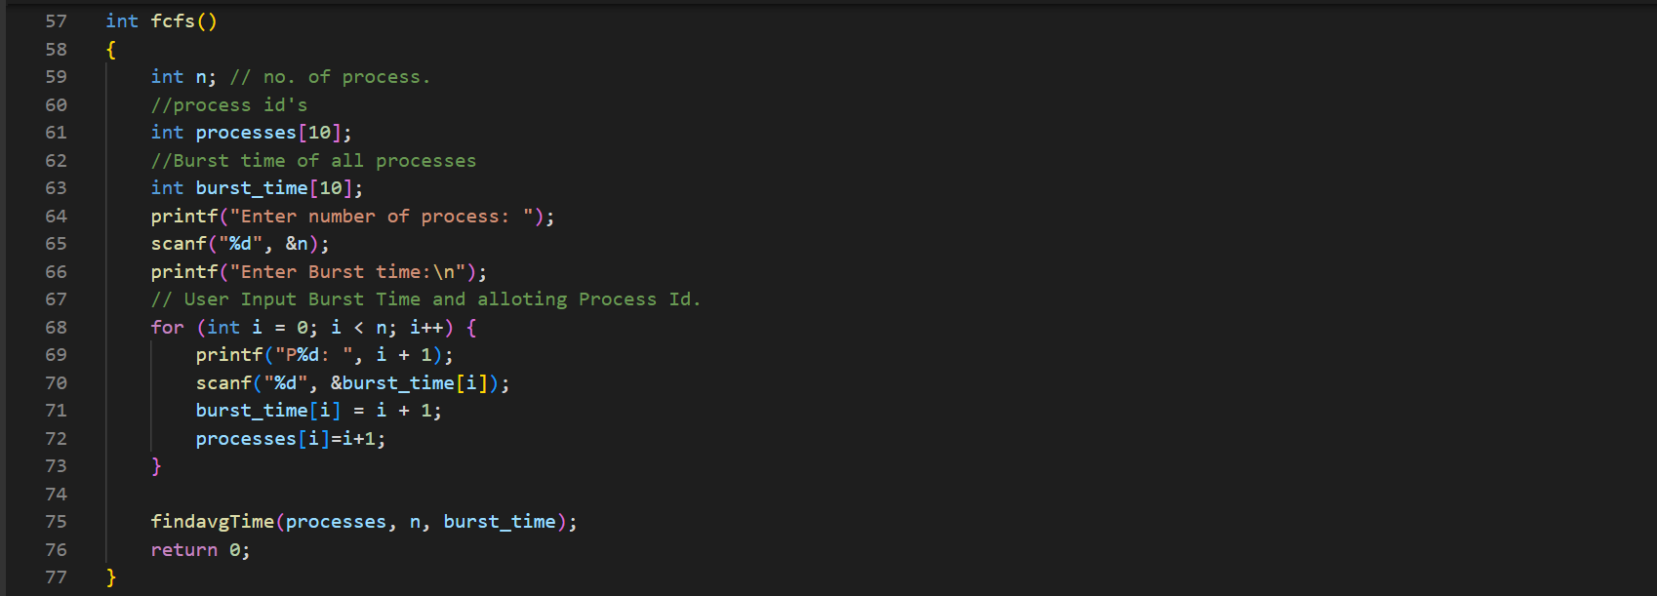

Slide 13
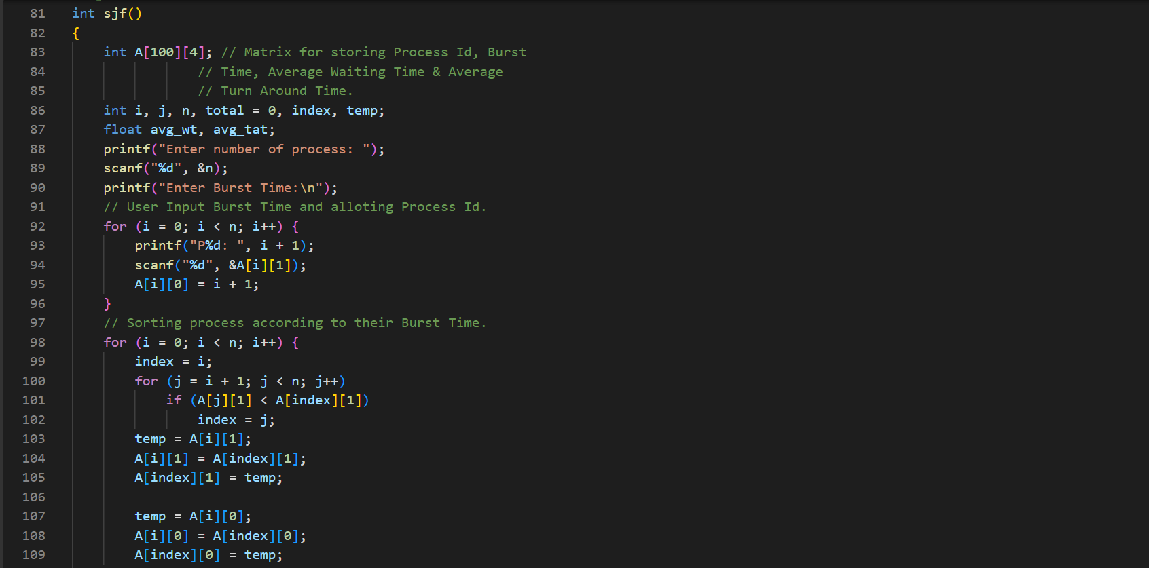

Slide 14
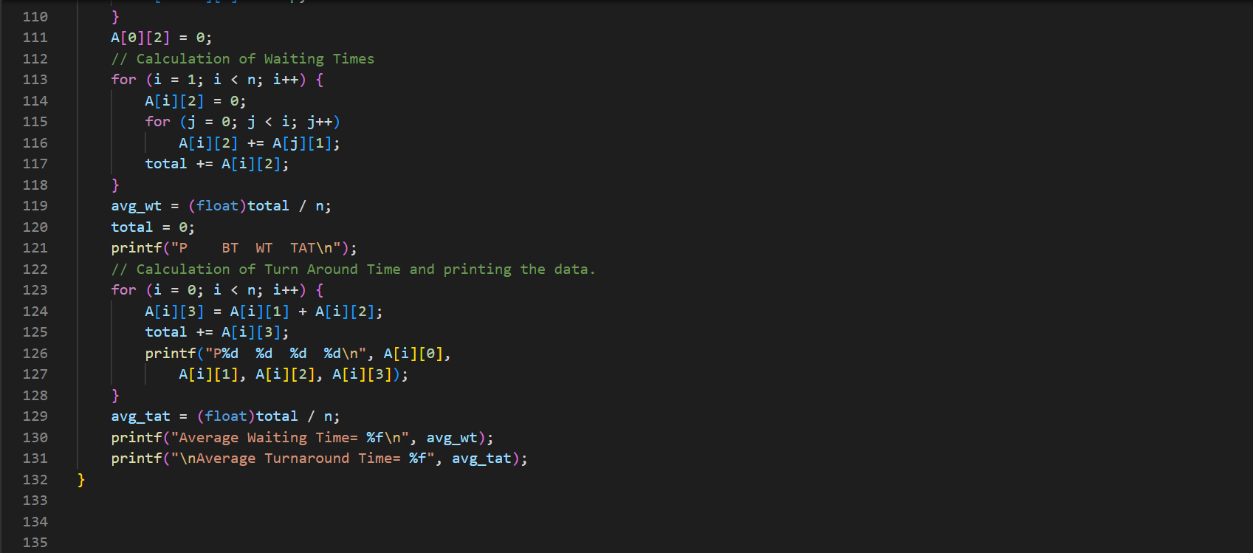

Slide 15
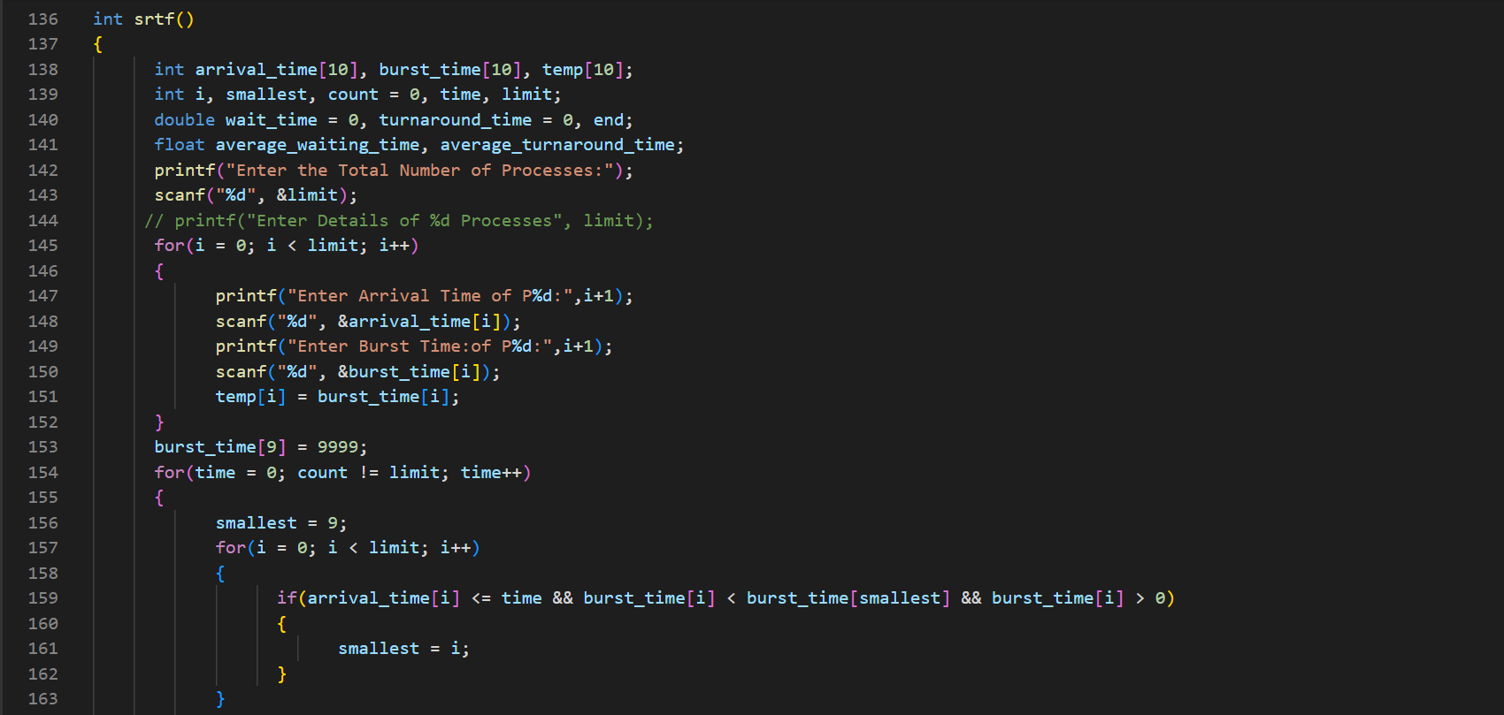

Slide 16
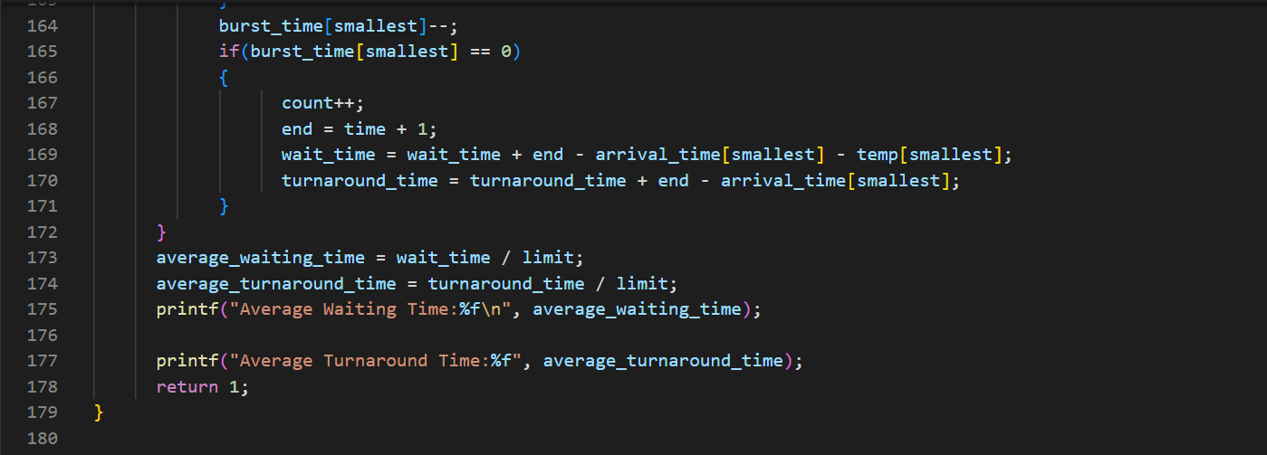

Slide 17
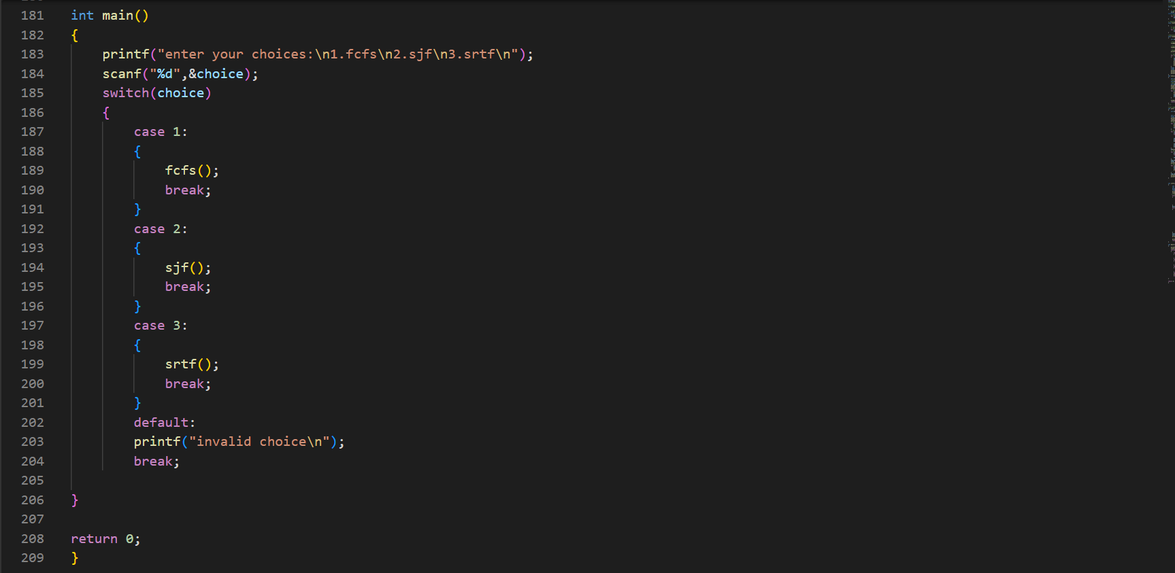

Slide 18
Thank you

